Slide 1
Social media analysis

Slide 2
Social Media Analysis in R
How can social media analysis in R help me with investment decisions?
There are several studies indicating that text sentiment highly correlates to stock price performance.
How can I use social media mining for my company?
Another very interesting application for that tool would be keyword research for your blog or to gather information on your competition.

Slide 3
social media analysis
1. Scraping the data
  This is the process where you get all the data from the various web platforms into your system.
  Data can be fetched from social media (Twitter is the most popular one for analysts) or even from the web.

Slide 4
Cont...
2. Mining, cleaning and making the data ready
  Only downloading millions of pages does not yield any success if you are not able to structure your data.
  In this step the corpus (the collected text including the meta-info) is processed, put together in one R readable document (quite often a special type of matrix) and useless text like stopwords or punctuation is removed.
3. Sentiment analysis
  This is the last step of the whole process. Basically you are comparing your corpus with a predefined sentiment lexicon. This can be an art itself and the approaches to it can vary quite a bit.
  A typical R package would be “sentiment”.

Slide 5

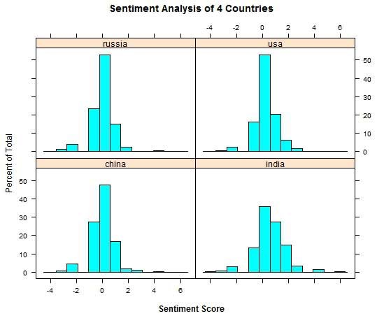
Example

